Slide 1
The evolutionary old forebrain as site of action to develop new psychotropic drugs
Anton J.M. Loonen & Svetlana A. Ivanova
https://doi.org/10.1177/0269881118798617

Slide 2
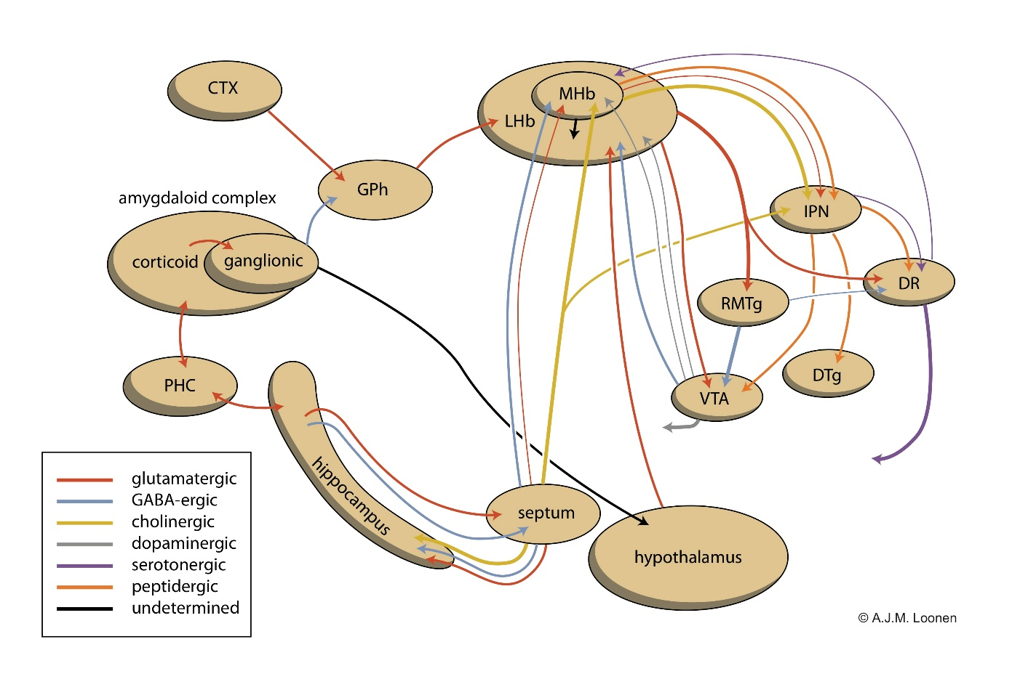
Figure 1
Notes:
Scheme showing the connectivity of the amygdalo-hippocampal system to the midbrain through the habenular complex. CTX: cerebral cortex; DR: dorsal raphe nucleus; DTg: dorsal tegmental nucleus; GPh: habenula-projecting part of the globus pallidus; IPN: interpeduncular nucleus; LHb: lateral habenula; MHb: medial habenula; PHC: parahippocampal cortex; RMTg: rostromedial tegmental nucleus; VTA: ventral tegmental area.
Figure has been adapted and updated in later publications.

Slide 3
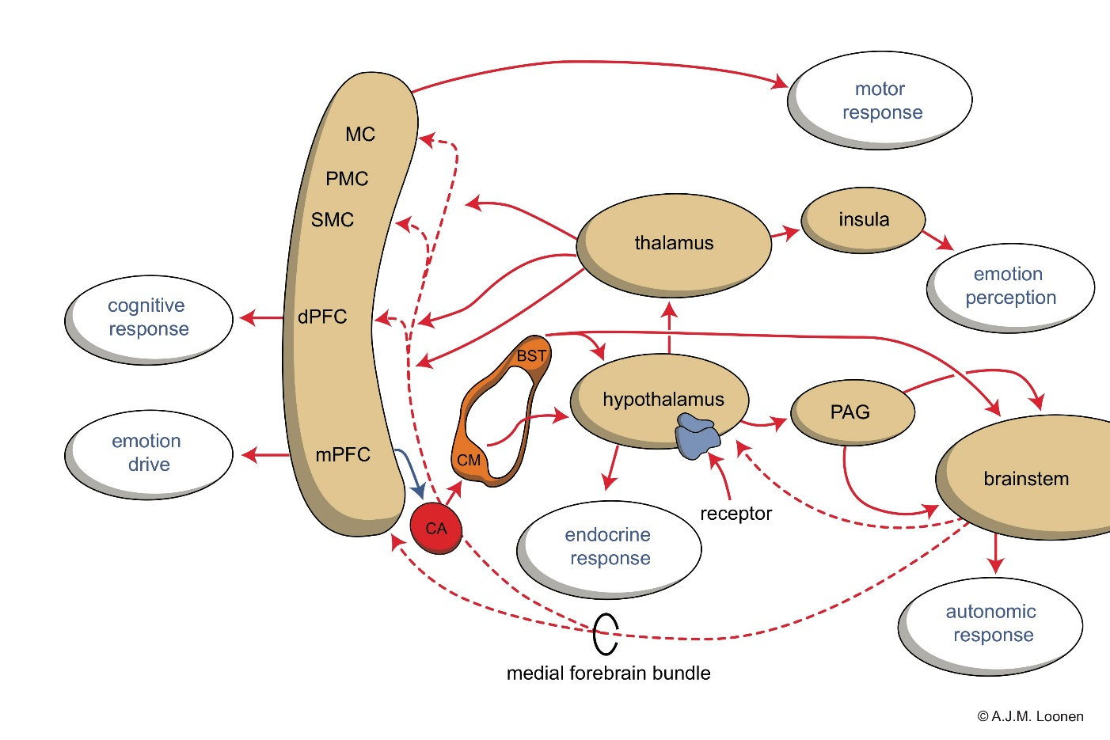
Figure 2
Notes:
Scheme showing the initiation and execution of the emotional response. BST: bed nucleus of the stria terminalis; CA: corticoid amygdala; CM: centromedial amygdala; dPFC: dorsolateral prefrontal cortex; MC: motor cortex; mPFC: medial prefrontal cortex; PAG: periaqueductal grey; PMC: premotor cortex; SMC: supplementary motor cortex.
This is the latest version of this figure

Slide 4
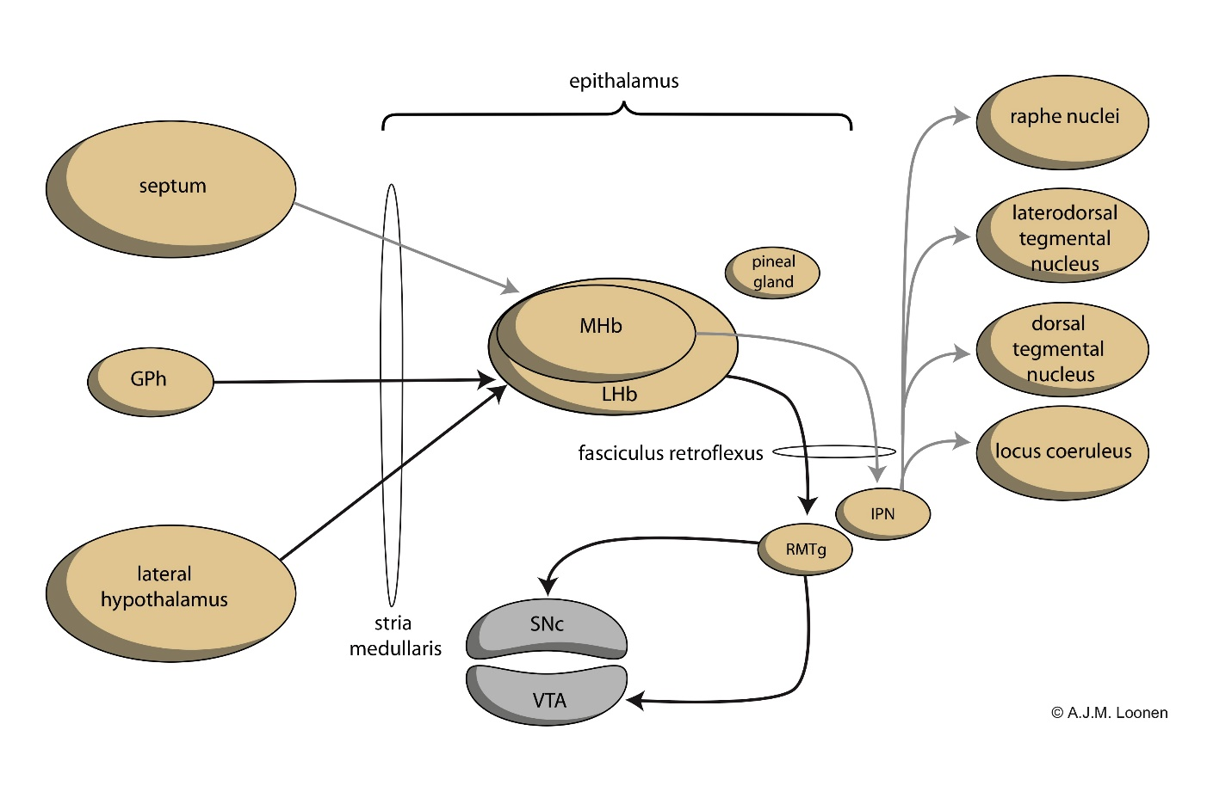
Figure 3
Notes:
Simplified representation of the connectivity through the epithalamus. GPh: habenula-projecting globus pallidus; IPN: interpeduncular nucleus; LHb: lateral habenula; MHb: medial habenula; RMTg: rostromedial tegmental nucleus; SNc: substantia nigra, pars compacta; VTA: ventral tegmental nucleus.
Figure has been adapted and updated in later publications.

